Slide 1
Balkan Nationalism 1800-1925
By Joe Calce

Slide 2
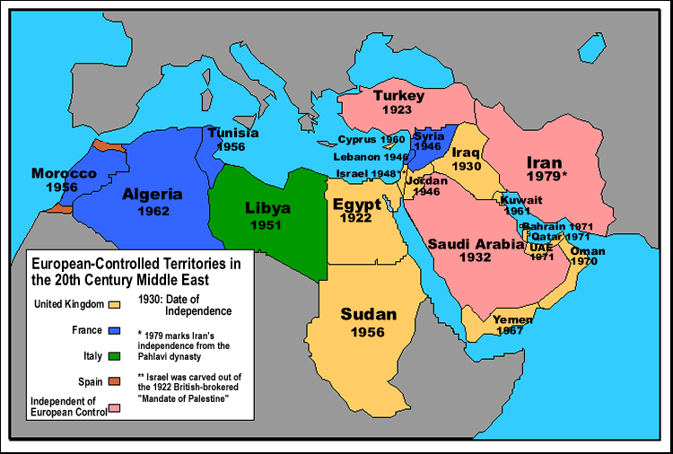
Arab Nationalism
Main goal: uniting the nations extending from Morocco to the Arabian Peninsula on their common culture and language
Sometimes included “Pan-Arabism”, a thought to unify the people under one nation, but not all believed in this concept
The conflict between Muslims and Christians throughout the Empire became a topic for debate
Muslims held emphasis on Qur’an and the united Arabs resulting from the rise of Islam
Christians showed disbelief in the hierarchy of the Muslims and their extended arguments led to controversy over the independent states in the 20th century
Often considered as a counter to Turkish nationalism, with the Young Turk Revolution of 1908
The Young Turk Revolution led to the creation of multiple pro-Arab nationalist societies, including al-Fatat and the Beirut Reform Society
Inspired the Arab Congress of 1913 to convene in Paris
The 1916-18 Arab Revolt is considered the epitome of the movement
Initiated by Sherif Hussein bin Ali, hoped to achieve independence from the Ottoman Turks
The members of the revolt also desired a single, unified Arab state from Aleppo, Syria→Aden, Yemen
This map shows the approximate area that the Arab nationalist movement spread to.

Slide 3
Arab Congress of 1913, Paris

Slide 4
Armenian Nationalism
Effort to reestablish Armenian state (First Armenian Republic) in Asia Minor
The Armenians were under the Armenian Apostolic Church, but with the rising Tanzimat reforms, they gained further rights
Tanzimat period included the Hatt-I Hümayun, promising the equality of all citizens of the Ottoman
1863-Armenian National Constitution written, defining the official powers of the millet and the Armenian National Assembly
Kanûn-I Esâsî written by the Young Ottomans at the peak of Arab nationalism
The Armenian National Assembly attempted to diminish the role of the aristocrats and neutralize the social classes

Slide 5
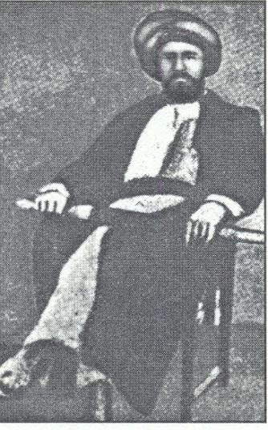
Bosnian Uprising
The sultans of the Ottoman attempted various economic reforms throughout the area of Bosnia
Resistance led by the captain Husein Gradaščević in 1831
The captain believed that the autonomy of Serbia and Greece would weaken Bosnia, so he organized a full-scale revolt
Defeated in 1832, and Gradaščević was later poisoned
The Ottoman Empire claimed Bosnia and Herzegovina until 1878, when the region became independent
The region was then absorbed into Austria-Hungary, and became the site for the assassination of Franz Ferdinand (Sarajevo, Bosnia)
Husein Gradaščević, leader of the rebels in Bosnia

Slide 6
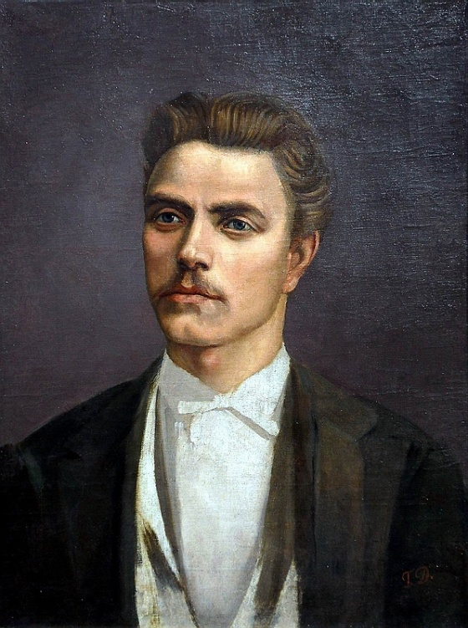
Bulgarian Revival
Bulgarian struggle for independence from the Ottoman Empire remained mostly peaceful
Ultimately resulted in the Bulgarian Exarchate
Vasil Levski involved himself in the Internal Revolutionary Organization and the Bulgarian Revolutionary Central Committee
April Uprising-1876 uprising throughout Bulgaria, met with hostility from the suppressors-->greater desire for independence
Bulgarian Horrors-consumed the rest of Europe with the terrible suppression
1876-77 Constantinople Conference—European sympathizers with Bulgaria proposed reforms, but the sultan refused
Bulgarian soldiers fought alongside the Russians in the Russo-Turkish War, and Bulgaria was granted autonomy at the Treaty of San Stefano
Vasil
Levski,
Bulgarian national hero

Slide 7
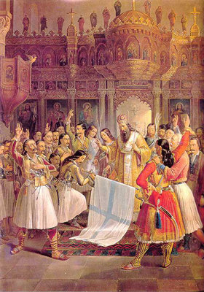
Greek War for Independence
The Greeks strived for independence throughout the 1820s and the early 1830s, and the assistance from other European nations allowed them to succeed.
Filiki Eteria
Secret organization formed by the Greeks in 1914 to liberate Greece from the clutches of the Ottoman Empire
Planned multiple revolts in: the Peloponnese, the Danubian Principalities, and Constantinople
Events of 1821
March 17-Maniots declare war on the Ottomans
Bishop Germanos of old Patras Blessing the Greek Banner at Agia Lavra, 1821.

Slide 8
Greek War for Independence
Timeline of the War (continued)
October 1821
Greeks, led by Theodoros Kolokotronis, captured Tripolitsa
Peloponnesian revolt continued in Crete and Macedonia, Greek navy achieved success against the Ottomans
Greek factions faced tensions, led to multiple civil wars and the sultan contacted the Egyptian Mehmet Ali for more troops
1825
Peloponnese under Egyptian control with Mehmet Ali’s son Ibrahim Pesha
1826
Missolonghi fell, after siege from the Turks since April 1825
1828
Greeks drove the Turks out of the Peloponnese upon intervention from Britain, Russia, and France, and attempted to regain central Greece
1832
Greece achieves full independence from the Ottoman Empire

Slide 9
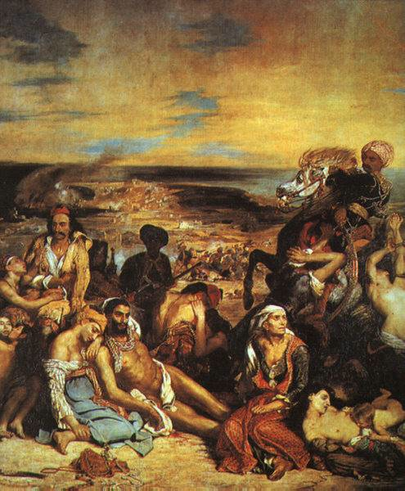
Eugene Delacroix’s famous Massacre at Chios, depicting the Ottoman attack on Greek civilians on April 11, 1822.

Slide 10
Kurdish Nationalism
The Kurds increased their influence and power, reaching to Angora
Wished for freedom from Ottoman control, but the Bedirkhan clan’s uprising in 1834 prompted stricter control from the Ottoman
Subjugation to Ottoman control introduced by Reshid Pasha, with strong garrisoning of the principal towns
Turks strengthened the hold on the country following the Crimean War as Bedr Khan Bey’s uprising was repressed
After the Russo-Turkish War, Sheikh Obaidullah founded an independent Kurd principality, albeit under the Ottoman Empire
1891-the Armenian Committees sympathized with the Kurds and believed their strength to be necessary with an irregular cavalry
The massacre of Armenians in Sasun and other places throughout the Balkans prompted action from the Kurds
Some Kurds, like some Arabs, wished for a Kurdish country

Slide 11
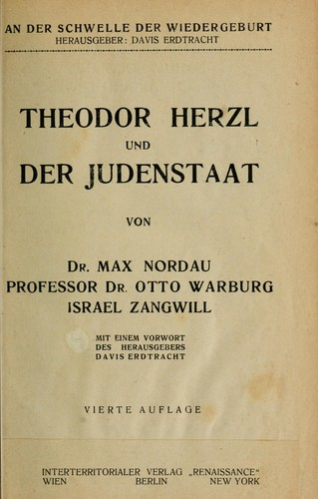
Homeland for the Jews
Under influence from the Zionism movement, which attempted to create a national identity for the Jews, the creation of a homeland for the Jews in the Promised Land resulted in the development of Israel.
Theodor Herzl first proposed a Jewish state in the late 1800s
Wrote Der Judenstaat (The Jewish State) in 1896, to express the beliefs of Zionism
As the Jews faced persecution, the sympathy throughout Europe led to the attempt for creating a homeland for the Jews
Richard Balfour, in 1917, wrote the Balfour Declaration, to express his views on the development of Israel in the region of the Palestine.
Included in the Sèvres peace treaty

Slide 12
The Macedonian Awakening
Belief in ethnic nationalism from enlightened individuals in Belgrade, Sofia, St. Petersburg, and Thessaloniki
Russian supporters of Slavic Macedonian nationalism were prevalent throughout the 1890s
Georgi Pulevski-identified the Slavic Macedonian culture and language, helped with the drive for nationalism
Following the Balkan Wars in 1912-1913, which resulted in the division of Ottoman Macedonia into three neighboring Christian states
Macedonian nationalism was explored following the First World War, especially in the Kingdoms of Yugoslovia and Bulgaria
Also significantly grew among the members of the Comintern

Slide 13
Romanian Awakening
Movement characterized by the Wallachian Uprising of 1821, anti-Ottoman drive between the Phanariotes under Vladimirescu and the Ottomans under Mahmud II
Encouraged by boyars and the Filiki Eteria, but became anti-Greek later
Mainly due to Tudor Vladimirescu’s compromise with the Ottoman in Bucharest and his trial and death
Ottoman intervened, but the Phanariote rulers identified with the cause of Greek nationalism
Sultan Mahmud II consented to two boyars (Ioan Sturdza and Grigore IV Ghica) as rulers of Moldavia and Wallachia
International Status of Romanian Lands in 1848

Slide 14
Serbian Revolution
One of the first successful campaigns against the Ottoman rule in the 19th century
National identity-found within the Serbian Orthodox Church
Continuous warfare throughout region of Belgrade Pashaluk→free peasants with little Ottoman control who served with the Austrians (military knowledge increased)
First Serbian Uprising-Janissary troops seized power in Belgrade, and prompted the belligerent peasants to rise against
Led to war throughout the region and spread to other Serbian struggles
Second Serbian Uprising-ultimately successful
Serbia supported multiple other nationalist movements, incl. Bosnia, Bulgaria, Macedonia
Ultimately resulted in the First Balkan War of 1912

Slide 15
Black Hand
Serbian nationalist movement, formed in 1901
Aimed to unite South Slavic populations not ruled by Serbia or Montenegro
Ultimately viewed as the organization that started WWI, fueled the July Crisis of 1914, led to Austria-Hungary’s invasion of Serbia
Assassination of Franz Ferdinand in Sarajevo believed to be actually committed by Young Bosnia
wwi.lib.byu.edu/index.php/Constitution_of_the_Black_Hand

Slide 16
Turkish Nationalism
Turanian society formed in 1839 by the Tatars
Fully-fledged Turkish nationalism developed in 1908 with the Turkish Society → Turkish Hearth, led to Pan-Turanism and Pan-Turkism
Found a new national identity under Mustafa Kemal with dissolution of the Ottoman Empire
The revolutionaries of the period rebelled against the partitioning of the Ottoman Empire
Led to ineffective Ottoman rule after Armistice of Mudros
Against the Treaty of Sèvres, which partitioned Anatolia
Under Ataturk, the Turkish revolutionaries fought the Turkish War of Independence with Armenian support
Eventually negotiated the Treaty of Lausanne, independence of Republic of Turkey, sovereignty over Eastern Thrace and Anatolia

Slide 17
Extended Reading/Viewing
Fantastic video series on World War I and its causes, touches on Balkan nationalism.
The Great War and Balkan Nationalism
Interesting YouTube videos on the Greek War of Independence, shows the heroes of the revolution particularly well.
Greek War of Independence Videos

Slide 18
Works Cited
Black Hand. Constitution of the Black Hand. World War I Document Archive, BYU Library, 2009. Web. 11 March 2014.
Cioranu, Mihai. Revolutia lui Tudor Vladimirescu, 1859. Web. 12 March 2014.
Fethi Okyar, Mustafa Kemal, et al. Mustafa Kemal, Ali Fethi, Cankaya Kopku, and Nermin Hanin, Turkish Archive, 2011. Web. 14 March 2014.
Gyzis, Nikoloas. After the Destruction of Psara (1896), National Gallery of Greece, Athens. Web. 12 March 2014.
Herzl, Thedor. “The Jewish State.” Jewish Virtual Library, 2014. Web. 12 March 2014.
Kemal, Mustafa. Order to the Turkish Army at the Battle of Sakarya, August 26, 1921.
Sultan Abdulmecid I, The Imperial Reform Edict of 1856. Bogazici University, Ataturk Institute of Modern Turkish History. Web. 12 March 2014.
Treaty of San Stefano. Preliminary Preace of San Stefano, University of Oregon Library Archives, 2011. Web. 10 March 2014.
“Turkey and the Great Powers.” The New York Times, January 16, 1877, New York Times Archive. Web. 10 March 2014.
Vesin, Jaroslav. By Bayonette (1913), National Museum of Fine Arts, Sofia, Bulgaria. Web. 11 March 2014.
Vryzakis, Thedoros. Germanos of Patras Blessing the Greek Flag at Agia Lavra (1865), National Gallery of Greece, Athens. Web. 11 March 2014.
“Wallachian Uprising of 1921.” Bucharest Archive, 2009. Web. 10 March 2014.
Young Arab Society (picture). Online Museum of Ottoman History, 1911.Web. 11 March 2014.

